Slide 1
使用fetch（）发出API请求并处理JSON API响应
Vocabulary: API, request, fetch(), response, JSON
Notes:
Coders should read aloud the objective.

Slide 2
API 和 JSON

Slide 3

什么是API?
Application Programming Interface 应用编程接口
使应用程序彼此发送消息，通信
Notes:
Teacher Notes:
If an application has an API, it means you can ask that application to perform certain tasks for you, like retrieving or storing some data. An API tells us what tasks we can ask another application to perform and how we can ask the other application to perform a that task.
You can ask the other application for these things by making a request to its API. The request has information about the task you want the other application to perform.
After the other application is done fulfilling your request, the API will return the application's response, which contains data from the task you requested.

Slide 4
API Response
API响应是API调用时发送回给您的数据（信息）的集合。
在浏览器的地址栏中输入此请求以查看响应：
http://demo3792399.mockable.io/热干面
mockable.io
Notes:
https://5c0aeda926902800135f6d07.mockapi.io/classes/1
https://pokeapi.co/api/v2/pokemon/1
Teacher Notes:
Feel free to customize with your own api. Use mockable.io

Slide 5
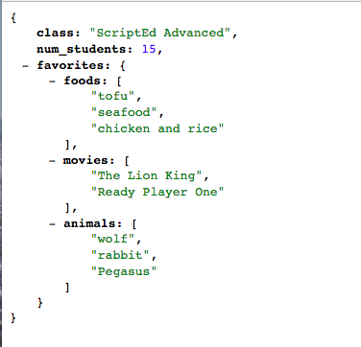
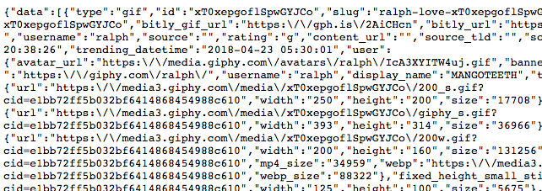

JSON
从Chrome app store下载 JSONView
大多数API响应都使用JSON。 （JavaScript对象object表示法notation）。
如果您注意，在页面加载后，它会变化。
这是因为JSONView扩展在工作。
它会更改数据，以便正确格式化对象并使其更易于阅读。
Notes:
Teacher Notes:
JSON is a common format for API responses. Does this look like something we've seen before in class?
JSON stands for JavaScript Object Notation. In fact, when we write JavaScript code, we can think of API responses as JavaScript objects!

Slide 6
JSON：JavaScript 对象表示法
var a = {
姓名: "周光明",
年龄: 16,
图片链接: "https://mms.businesswire.com/media/20181031005146/en/687557/23/CN_Logo_Black-01.jpg",
网站: "https://codenation.org/",
喜欢的: {
"食物": ["热干面", "海鲜", "鸡肉和米饭"]
}
}

Slide 7
请求（Fetch）

Slide 8

您如何发出API请求？
fetch()允许我们从网站请求数据，并要求他们返回响应
Notes:
Teacher Notes:
There's a lot of different ways that we can have one application can talk to another application but we'll be using a method called fetch().
The apps we've written thus far only make requests when the page loads; they ask for things like JavaScript and CSS files. With fetch(), our app can keep making requests for things even after the app page is done loading!

Slide 9
您如何提出fetch（）请求？
这是一个fetch（）请求。
首先，您需要一个函数，返回JSON响应
然后，您需要一个函数，访问嵌套在响应中的信息（数据）
使用什么参数？
fetch(“<API链接>")
.then(
function(响应) {
return 响应.json();
}
)
.then(function(数据) {
// 数据处理代码
});
Notes:
Teacher Notes:

Slide 10
fetch Request
fetch("http://demo3792399.mockable.io/guangming")
.then(function(响应) {
return 响应.json();
})
.then(function(数据) {
console.log(数据);
});
请求URL
Notes:
Teacher Notes:

Slide 11
练习时间

Slide 12
游戏时间
第一个游戏：搜索电视剧
第二个游戏：搜索小精灵
作业2：完成搜索电视剧功能，能够按照你的输入，进行搜索
加分项：加你的创意
Notes:
Teacher Notes:
This is the hook activity. Please adjust to appeal to your class culture.

Slide 13
项目时间

Slide 14
游戏时间
访问 https://giphy.com/
搜索并分享一些有趣的gif。
- 学校
- 小狗
- 您最喜欢的适合课堂的gif
Notes:
Teacher Notes:
This is the hook activity. Please adjust to appeal to your class culture.

Slide 15



Giphy API 项目
做一个你自己的 Giphy!
https://itscodenation.github.io/adv_giphy_sol_3/
https://api.giphy.com/v1/gifs/search?q=puppy&rating=pg&api_key=dc6zaTOxFJmzC
Notes:
Teacher Notes:
Get coders excited! Let students play with the application and discover the functionality.
Have students click the link and have students interact with website; ask them to pull up some class-appropriate gifs!
After they've spent some time interacting with the code, have students turn and talk to discuss how they might make something similar.

Slide 16

小组讨论
用户如何与网站互动
互动时会发生什么
看看网站的样子，想想哪些部分你已经会构建？
网站哪里用到了API？
你将如何使用API，构建这个网站？
Notes:
Teacher Notes:
Have students turn and talk to discuss how to make the sample project. As students are discussing the questions above, make sure they're writing their thoughts down.

Slide 17
尝试Giphy API
在浏览器中尝试
https://api.giphy.com/v1/gifs/search?q=狗&rating=pg&api_key=dc6zaTOxFJmzC
Notes:
Teacher Notes:
Have students turn and talk to discuss how to make the sample project. As students are discussing the questions above, make sure they're writing their thoughts down.

Slide 18
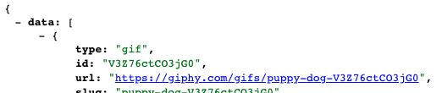

来找一些有趣的动画吧
https://api.giphy.com/v1/gifs/search?q=狗&rating=pg&api_key=dc6zaTOxFJmzC
让我们看看这个URL
https://giphy.com/gifs/puppy-dog-V3Z76ctCO3jG0
Notes:
Teacher Notes:
You should work together to do Questions 1 and 2 before allowing students to complete the rest of the activity independently. Tell students not to worry about about all the other code. They should just worry about the response and using the response to get what they want in the console.
https://popcode.org/?snapshot=7cf2d616-76dc-4301-a9f8-e518555e7cbc

Slide 19
项目设置
确保您已从Chrome应用商店下载了JSONView
Notes:
Teacher Notes:
If your students are using chromebooks, make sure they are signed in under their own gmail accounts. Otherwise, they might have trouble installing the JSONView extension.

Slide 20
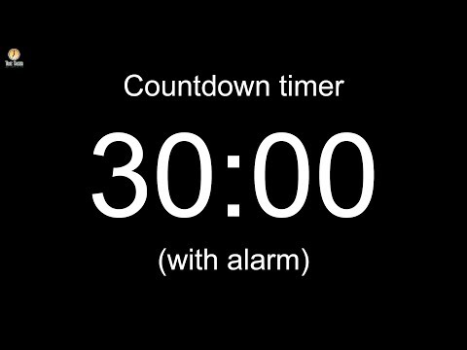
第一部分：
1）添加所需的HTML元素（输入框，按钮，显示结果的位置）
2）使用以下URL进行fetch（）
https://api.giphy.com/v1/gifs/search?q=狗&rating=pg&api_key=rQrXp8Skecms5IYqoh0BS4HeQW9L35LY
3）控制台记录响应

Slide 21
识别API请求中的搜索关键字，使用用户输入对其设置
Vocabulary: API Request URL
Notes:
Coders should read aloud the objective.

Slide 22
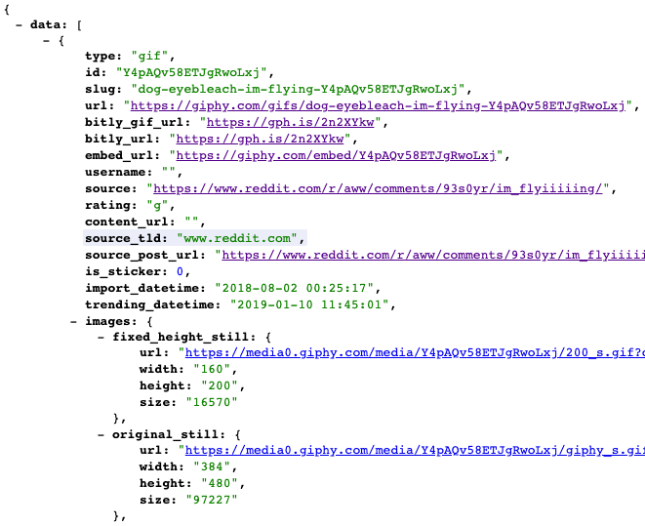
回顾: API 请求
这是我们一直在使用的向Giphy API发出的API请求的示例：
api.giphy.com/v1/gifs/search? q=狗&rating=pg& api_key=dc6zaTOxFJmzC
Notes:
Teacher Notes:
An API is basically a large object generated by a company that is sharing their code with you!

Slide 23
分解：API网址
这告诉我们正在使用哪个网站的哪个API
api.giphy.com/v1/gifs/search?q=狗&rating=pg&api_key=dc6zaTOxFJmzC
Notes:
Teacher Notes:
An API is basically a large object generated by a company that is sharing their code with you!

Slide 24
分解： API 功能
这告诉我们正在使用API的哪种功能。在这里我们将搜索（search）
api.giphy.com/v1/gifs/search?q=狗&rating=pg&api_key=dc6zaTOxFJmzC
Notes:
Teacher Notes:
An API is basically a large object generated by a company that is sharing their code with you!

Slide 25
分解: API 参数
像函数一样，API接受参数，因此我们可以告诉我们要搜索的内容
此函数具有3个参数：
- q：搜索关键词
- Rating：评分
- api_key：访问API的密钥（每个用户一个）
api.giphy.com/v1/gifs/search?q=狗&rating=pg&api_key=dc6zaTOxFJmzC
Notes:
Teacher Notes:
An API is basically a large object generated by a company that is sharing their code with you!

Slide 26

API 文档
我们如何知道我们的请求应该是什么样的？？？
文档，文档，文档。
https://developers.giphy.com/docs/
Notes:
Teacher Notes:
Show the documentation page but don't spend too long looking at this

Slide 27

我们用于项目的API请求URL中的搜索词是什么？
我们需要更改什么，以便搜索用户想要搜索的内容？
https://api.giphy.com/v1/gifs/search?q=狗&rating=pg&api_key=dc6zaTOxFJmzC
Notes:
Teacher Notes:
An API is basically a large object generated by a company that is sharing their code with you!

Slide 28
API 请求链接
我们可以通过更改q：查询关键字，来找到不同的图片。
将以下链接粘贴到您的浏览器中，并观察找到的gif文件是不是你想要的
api.giphy.com/v1/stickers/search?q=狗&rating=pg&api_key=dc6zaTOxFJmzC
api.giphy.com/v1/stickers/search?q=猫&rating=pg&api_key=dc6zaTOxFJmzC
api.giphy.com/v1/stickers/search?q=艾克&rating=pg&api_key=dc6zaTOxFJmzC
Notes:
Teacher Notes:
An API is basically a large object generated by a company that is sharing their code with you!

Slide 29
回顾: 点击处理器（Click）
我们设置了一个jQuery单击处理程序，以便当用户按下按钮时，我们的代码立即生效。
$(“按钮").click(function() {
// 我们的代码
});
Notes:
Teacher Notes:
To move things along faster we don't assign a button id in this example.
Ask students, "What do you think we'll put inside the click handler?"

Slide 30
input.val() 取用户输入的内容
然后，我们可以使用jQuery检索输入的值并将其显示在文本中。
$(“按钮").click(function() {
var 用户搜索关键字 = $(“输入").val();
});
Notes:
Teacher Notes:
What's the difference between "#message" and message? Desired response: One is a div with the id of message and the other one is a variable named message.

Slide 31
input.val()
我们可以使用串联将输入的值添加到我们的API请求网址中
let 搜索链接 = “https://api.giphy.com/v1/stickers/search?q=” + 用户搜索关键字 + "&api_key=dc6zaTOxFJmzC";

Slide 32

第二部分
- 从输入框中获取用户输入
- 根据用户输入更新API请求网址
- 根据输入框中输入的内容在屏幕上显示不同的图像
- 添加CSS样式

Slide 33
项目扩展（自选）
Notes:
Coders should read aloud the objective.

Slide 34
扩展 1
返回的搜索结果里，其实有很多Gif
创建一个“下一个”按钮，选择下一个gif。
Notes:
Teacher Notes:

Slide 35
扩展 2
2.在屏幕响应中显示所有图像。
Notes:
Teacher Notes:

Slide 36
其它API

Slide 37
B站API
视频基本信息
http://api.bilibili.com/archive_stat/stat?aid=AV号&type=jsonp
(AV号、观看、弹幕、评论、收藏、硬币、分享、喜欢、版权[1自制2转载])
https://www.bilibili.com/read/cv3430609/
https://github.com/SocialSisterYi/bilibili-API-collect
https://github.com/topics/bilibili-api
Notes:
Teacher Notes:
This is the hook activity. Please adjust to appeal to your class culture.

Slide 38
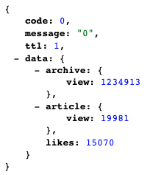
B站API
UP主信息
https://api.bilibili.com/x/space/upstat?mid=UUID&jsonp=jsonp
(视频总播放数、文章总浏览数)
space: 空间
例：https://api.bilibili.com/x/space/upstat?mid=25150941&jsonp=jsonp
Notes:
Teacher Notes:
This is the hook activity. Please adjust to appeal to your class culture.

Slide 39
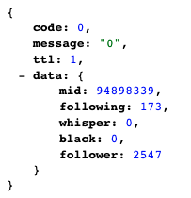
B站API
UP主信息2
https://api.bilibili.com/x/relation/stat?vmid=UUID&jsonp=jsonp
(UUID、关注数、黑名单、粉丝数)
relation：关系
https://api.bilibili.com/x/relation/stat?vmid=25150941&jsonp=jsonp
Notes:
Teacher Notes:
This is the hook activity. Please adjust to appeal to your class culture.

Slide 40
豆瓣API
电影信息
https://api.douban.com/v2/movie/subject/30261964?apikey=0df993c66c0c636e29ecbb5344252a4a
正在上映
http://api.douban.com/v2/movie/in_theaters?apikey=0df993c66c0c636e29ecbb5344252a4a&start=0&count=10

Slide 41
网易云音乐API
http://music.163.com/api/v1/resource/comments/R_SO_4_{歌曲ID}?limit=20&offset=0
https://cloud.tencent.com/developer/article/1543945

Slide 42
中国大陆可用API合集
2017-10-19
https://juejin.im/entry/59e85ee1f265da433561dec0
笔记，出行，词典，电商，地图，电影，即时通讯
开发者网站，快递查询，旅游，社交，视频
天气，团队协作，图片与图像处理，外卖
消息推送，音乐，云，语音识别，综合

Slide 43
史上最全】国内外常用精品API接口汇总
https://cloud.tencent.com/developer/article/1452237

